Slide 1
Predictions About Epileptic Seizures Detections
BBM469 Data Intensive Applications Laboratory
Data Science Capstone Project
Ozar Ömer Uncu – Uğurcan Bağrıyanık

Slide 2
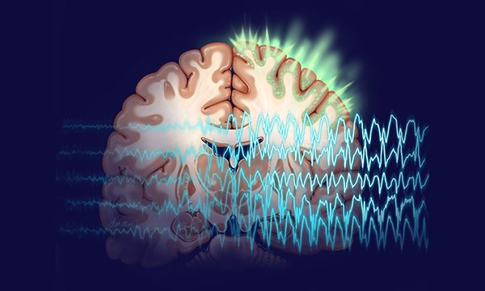
Problem

Slide 3
Epilepsy cause seizures cause electrical activities in the brain. These can cause some symptoms at people's life. There is test method for detect person have epileptic seizure or not by activities of the brain. Neurologist need to see output of the test and they can see values at any person have seizure or not. There can be large amount of data feature or columns for one person. We want to help neurologist for predict these kind of seizures detection. We build data science project for predict person have seizures or not with some classification methods. Our aim is we want to use classification method which contributes best accuracy score. And do not have a wrong predictions for this health issue. For the solution we choose best classification method for our dataset to detect have seizure or not. Also, we improve our prediction accuracies with different technics used by data scientists. We choose our classification method as Random Forest Classifier. And improve accuracy with PCA technics. You can see extended information about these methods at our notebook.

Slide 4

Data Understanding

Slide 5
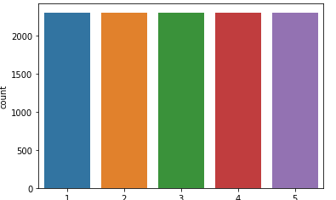
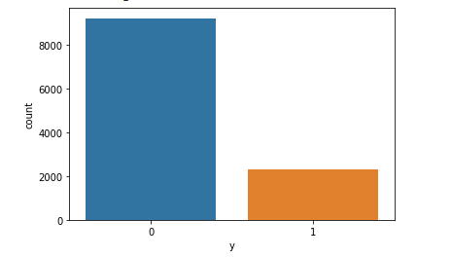
Each line of dataset represent one person’s brain activities. We have 178 feature as our data’s columns and 11500 pieces of information. Each feature that contains data at 1 second interval. Our last column contains persons mode at EEG recording. And we are going to reduce our 5 different mode to 2 mode, these are going to be have epileptic seizure or not. You can access extended information at our notebook. You can see mean value, min - max values, etc. When we reduce our recording outputs to have seizure or not, we draw graph for see distribution between persons.
Graph for not modified data.
Graph for modified data

Slide 6

Data Preparation

Slide 7
We need to drop last column which contains our aims to predict. First, we drop this column and than we will not be drop any column. For that reason, we want to see correlations between columns for select to drop column. But we can not see good correlation. So decided to pass this process to later .We will use different method for decrease our columns to work on. We will pair these columns later. We need to normalize our data for negative values at our dataset. We use min-max normalization at our notebook. And gave brief information about it on the notebook.

Slide 8

Modeling

Slide 9
We train our data first for modelling we split our data by %70 to %30 . And fit these data to min-max scaling. We need to detect best classification model for our dataset. So, we create models with some classification methods. We choose Xgboost, SVC, DecisionTree, RandomForest and KNN classification methods. You can see details of these classification methods at our notebook. We printed all accuracy of these classifications for compare them. And we gave some brief information about all classification methods at our notebook. Then we mentioned about our choose. We explain why we choose random forest again at our notebook. Next, we did not drop any columns at our data preparation part. But we need to improve our classification with modify columns. We used PCA for reduce our dimension for pass variables to pipeline. We choose 45 component because our PCA graph has elbow at 40-50 range. So, we will be used these components. We take this process to our pipeline . And give train variables for see best classification method and randomly choose good classification for comparing.

Slide 10

Evaluation

Slide 11
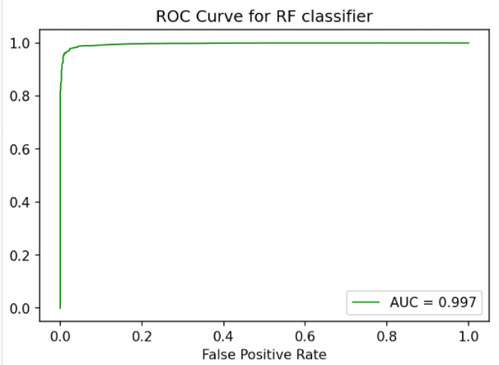
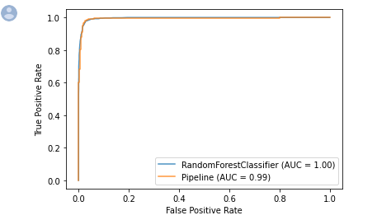
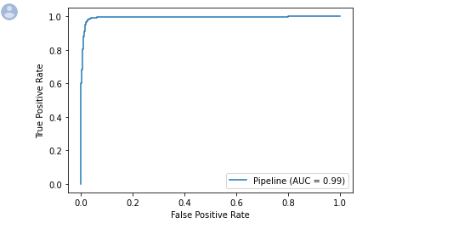
We can see roc curves for Random Forest Classification and SVC. There is little difference at their scores.

Slide 12
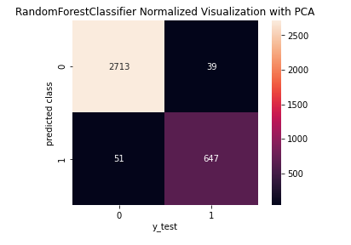
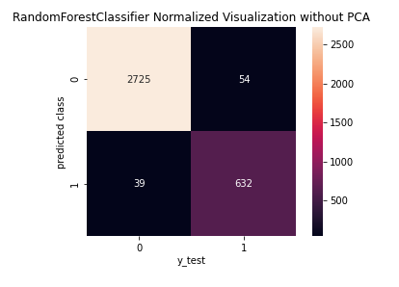
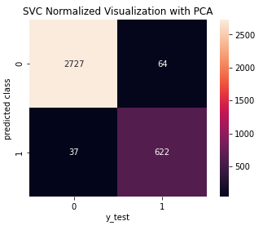
We can see difference between RF classifier with PCA and without PCA. Also, we can see difference between SVC and RF classifiers too. We have good predictions scores.

Slide 13
From the last confusion matrices, we believe our model can provide nice results. We think this classification models can help neurologists for detect epileptic seizure. And these models can speed up these procedures that will be use for detection of epileptic seizure.

Slide 14
References
ROC Eğrisi (ROC Curve) – Veri Bilimcisi
PCA ( Principal Component Analysis) Temel Bileşenler Analizi | by Gülcan Öğündür | Medium
Epilepsy: Causes, Symptoms, Treatment, and More (healthline.com)
Roc Eğrisi ve Eğri Altında Kalan Alan (Auc) | by Berna Taş | Medium

